Slide 1
The Threat to Flat Rock Gully and Tunks Park

Slide 2
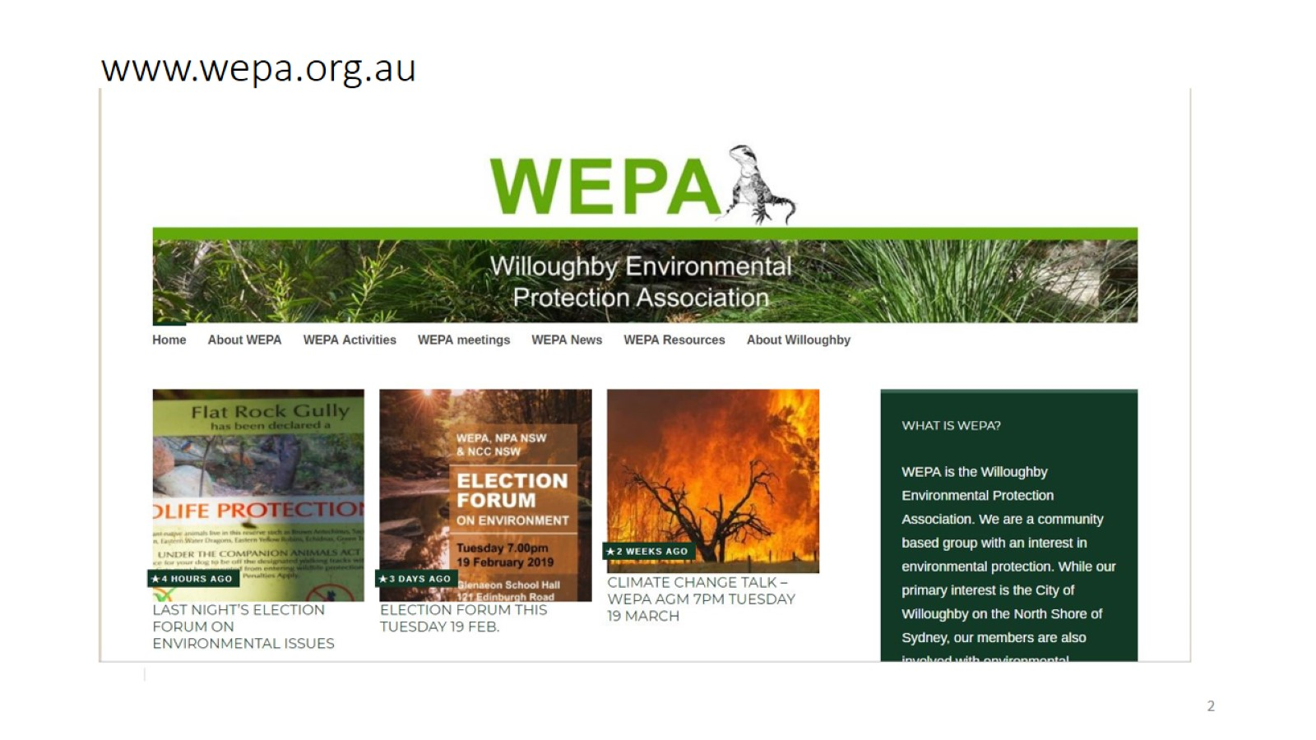
www.wepa.org.au

Slide 3
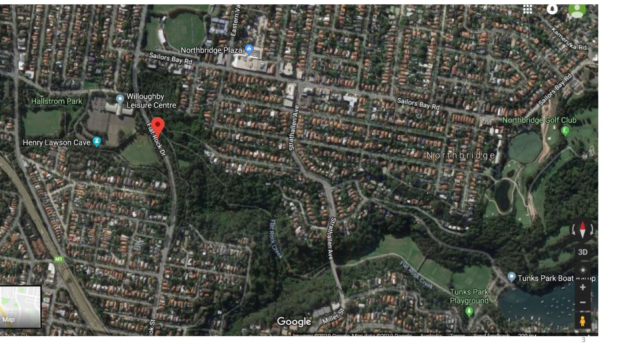
Flat Rock Gully Catchment

Slide 4
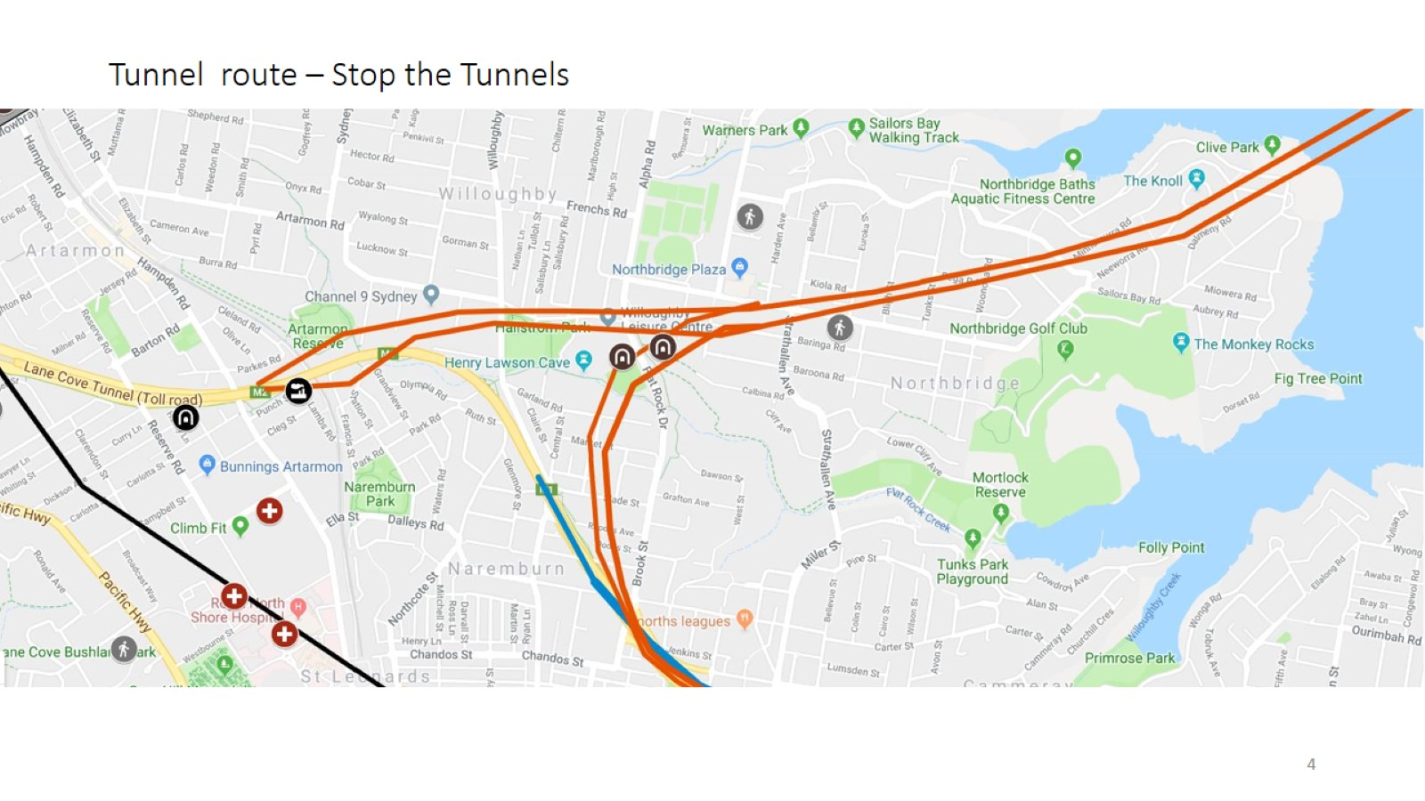
Tunnel route – Stop the Tunnels

Slide 5
Long Gully/Suspension Bridge – showing creek c1905

Slide 6
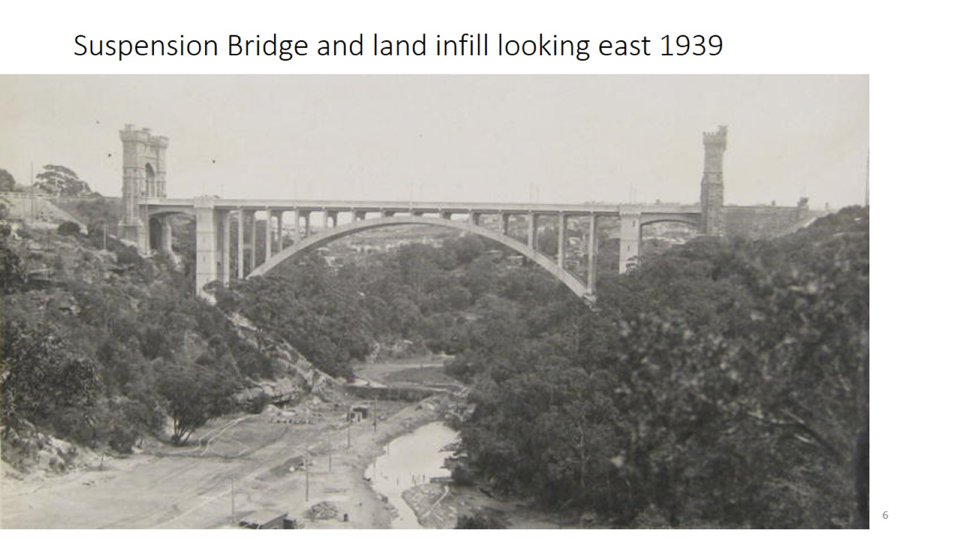
Suspension Bridge and land infill looking east 1939

Slide 7
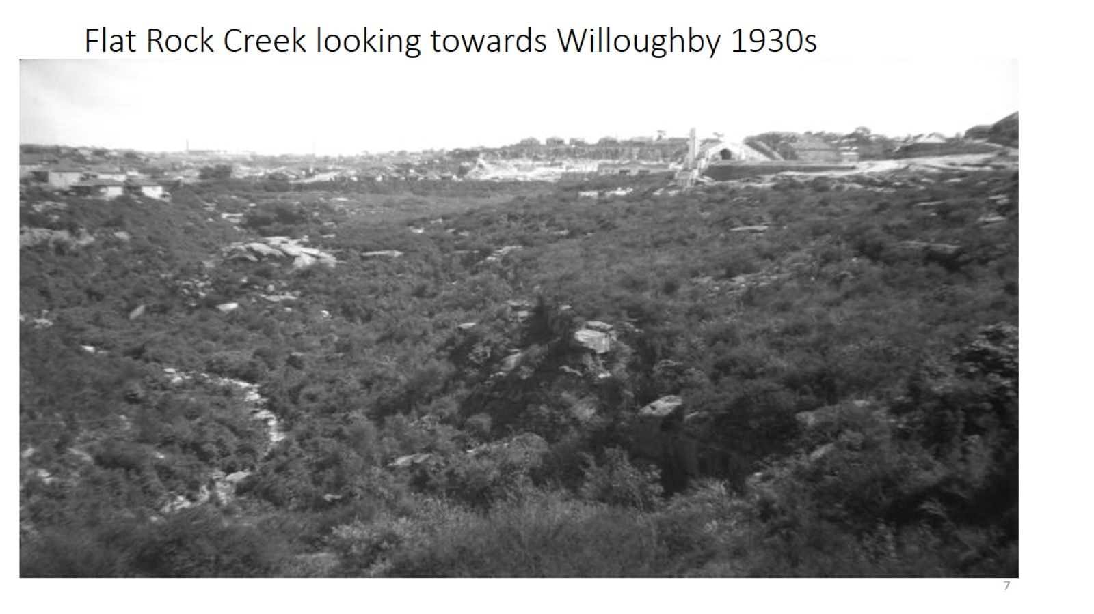
Flat Rock Creek looking towards Willoughby 1930s

Slide 8
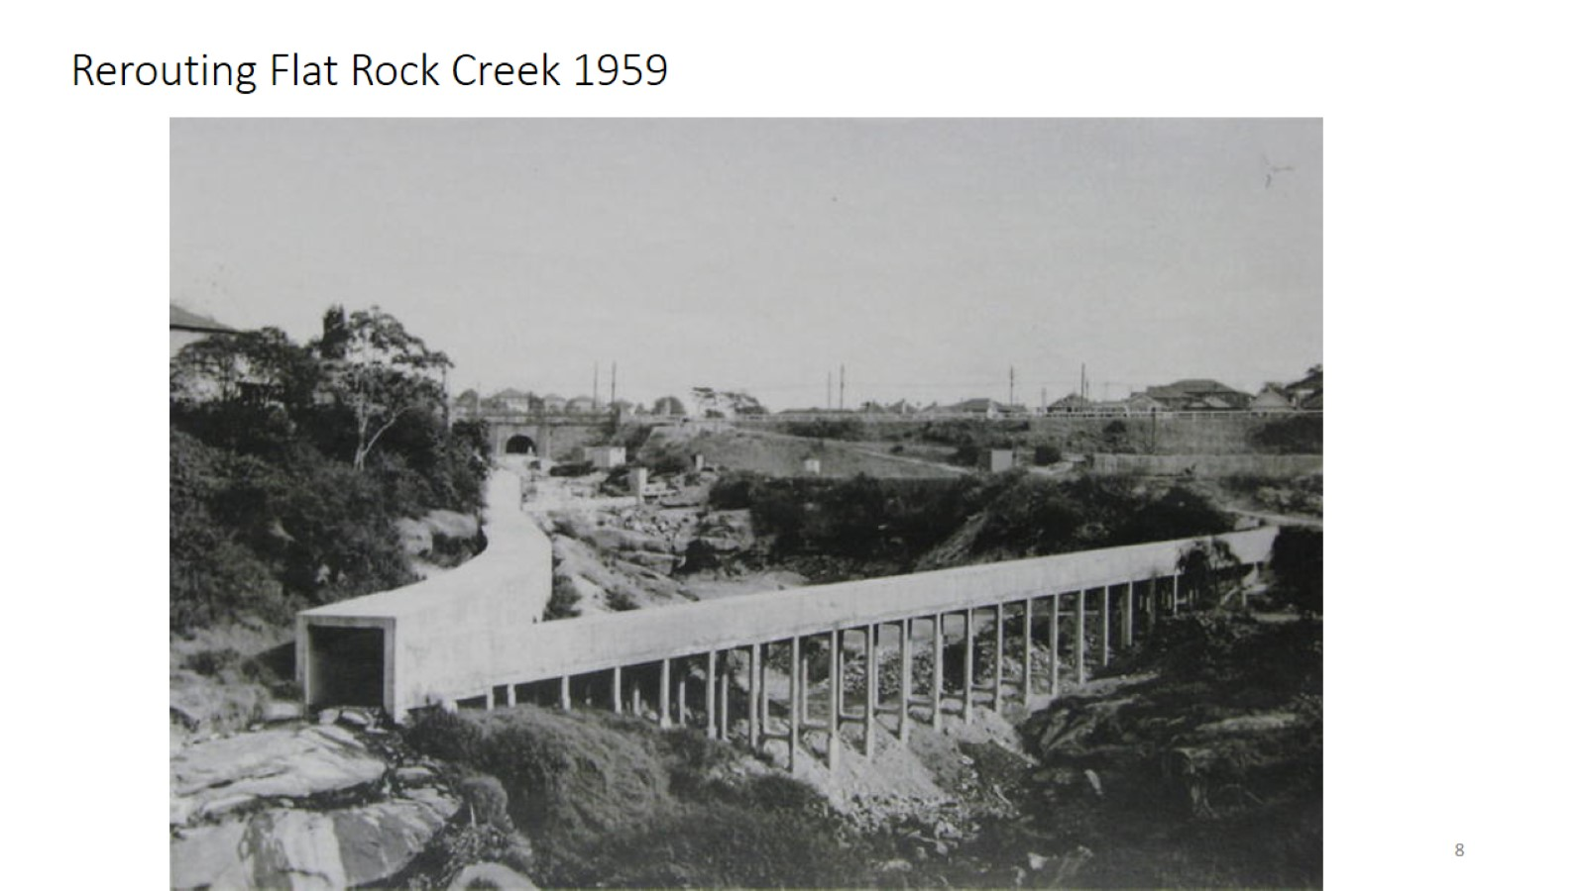
Rerouting Flat Rock Creek 1959

Slide 9
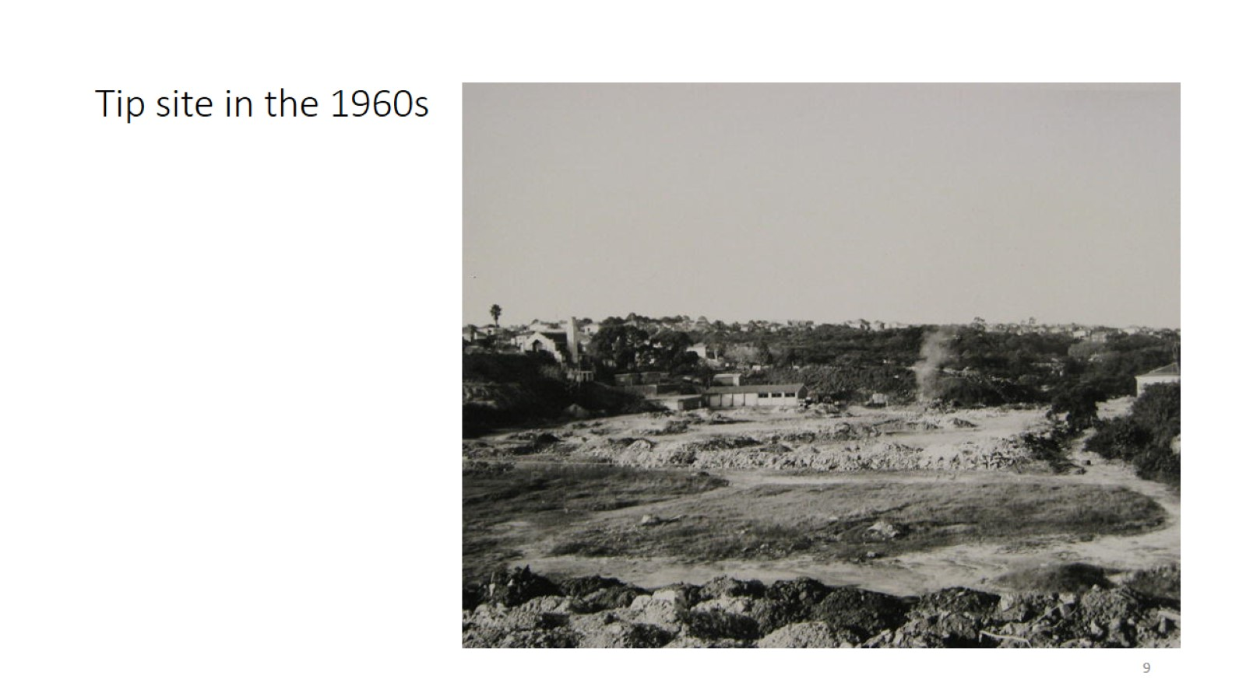
Tip site in the 1960s

Slide 10
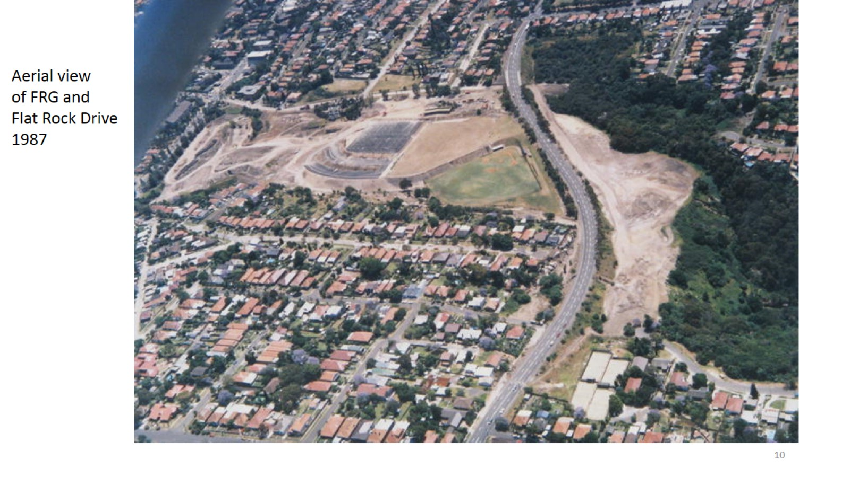

Slide 11
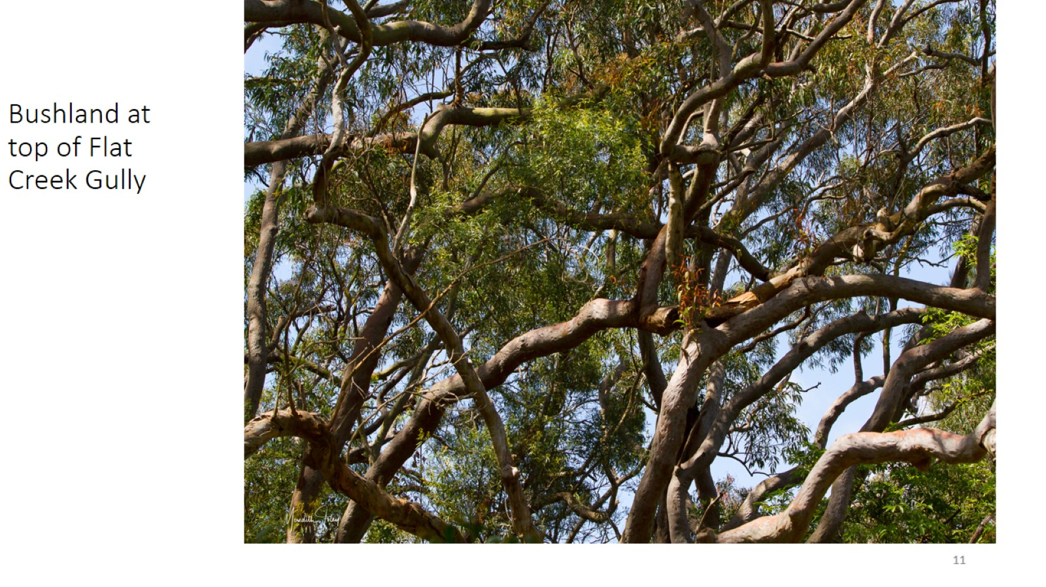
Bushland at top of Flat Creek Gully

Slide 12
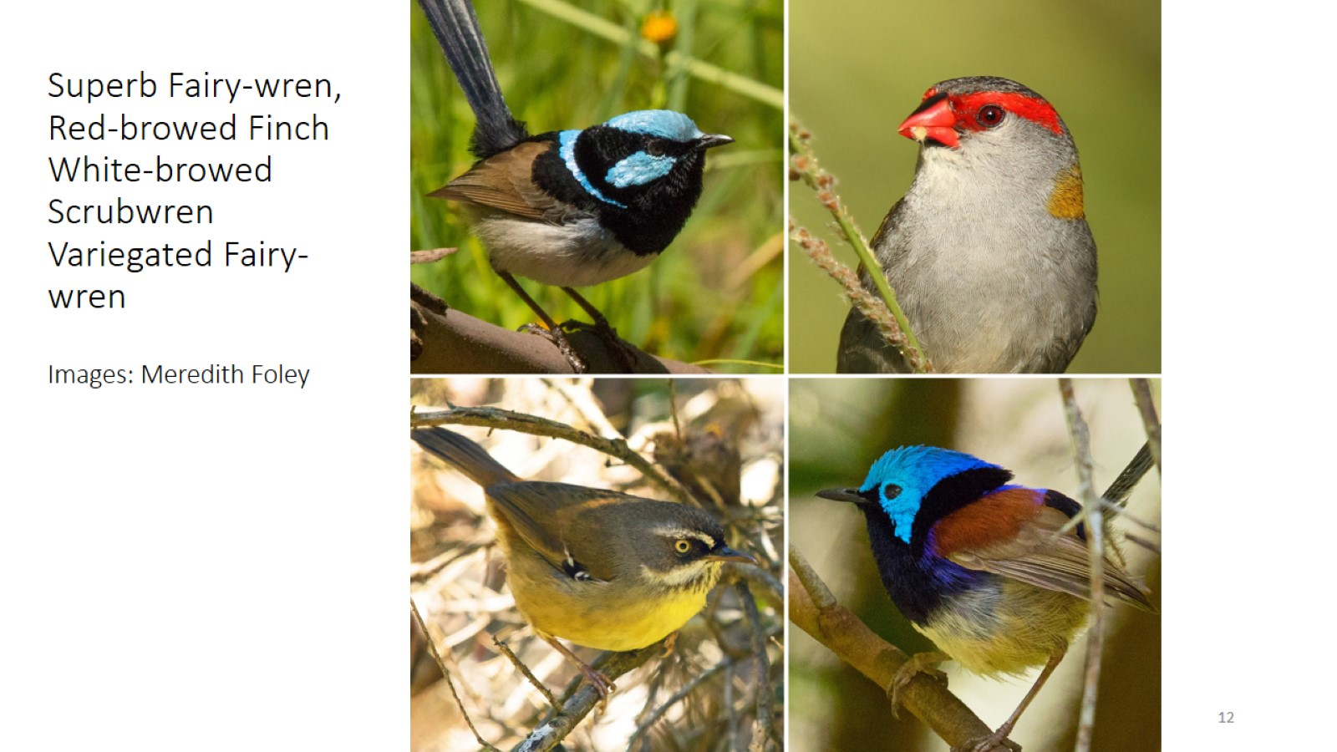
Superb Fairy-wren, Red-browed Finch White-browed Scrubwren Variegated Fairy-wren Images: Meredith Foley

Slide 13
Grey Goshawk – white morph in FRG – Image: Ronwyn North

Slide 14
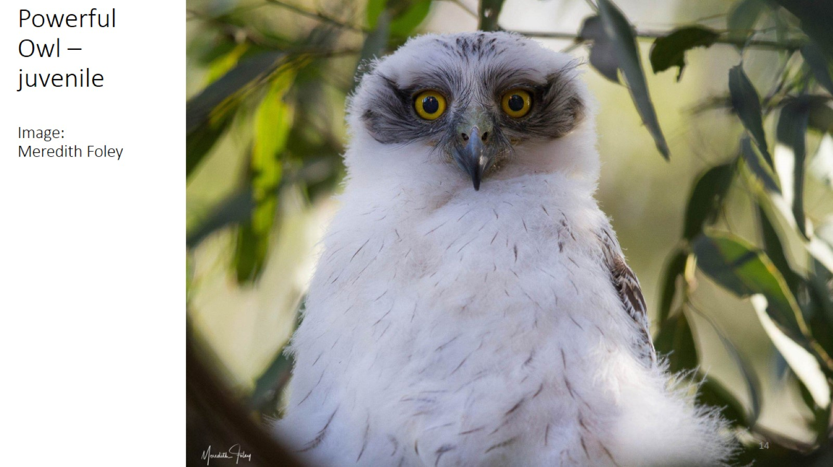
Powerful Owl – juvenile Image: Meredith Foley

Slide 15
Recent photo by Northbridge local, Charlotte Hunter

Slide 16
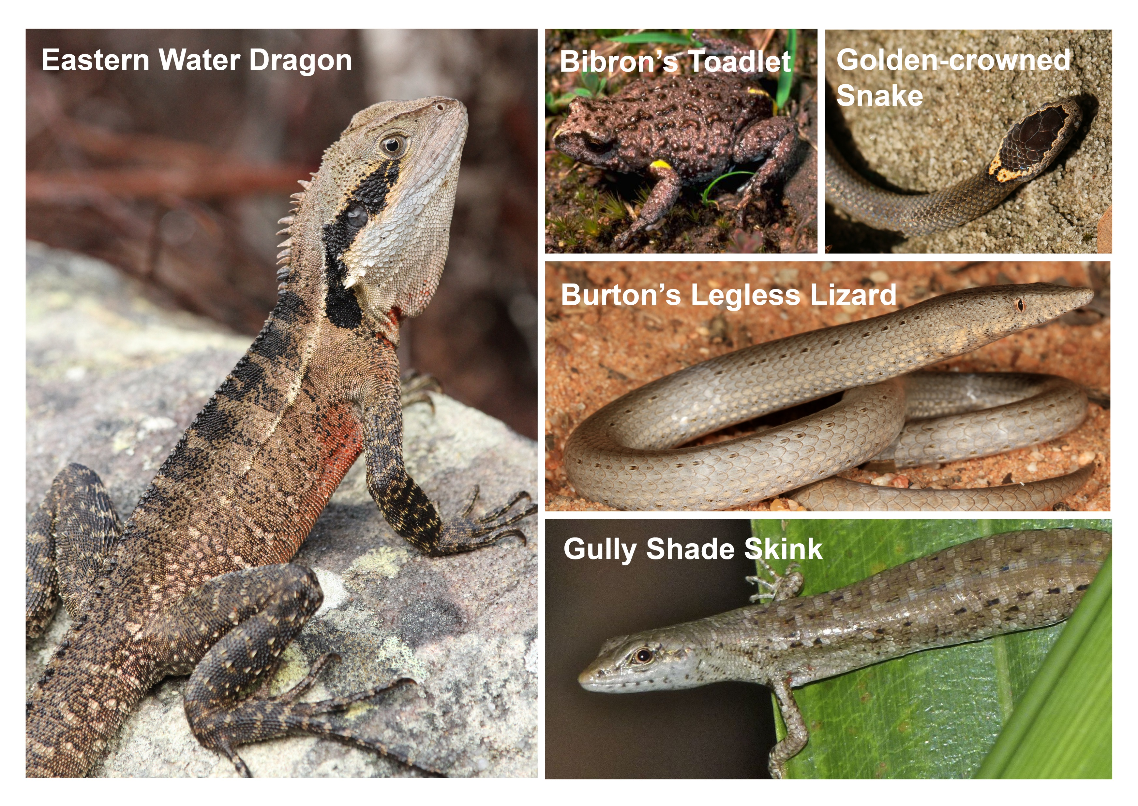

Slide 17
Short-beaked echidna

Slide 18
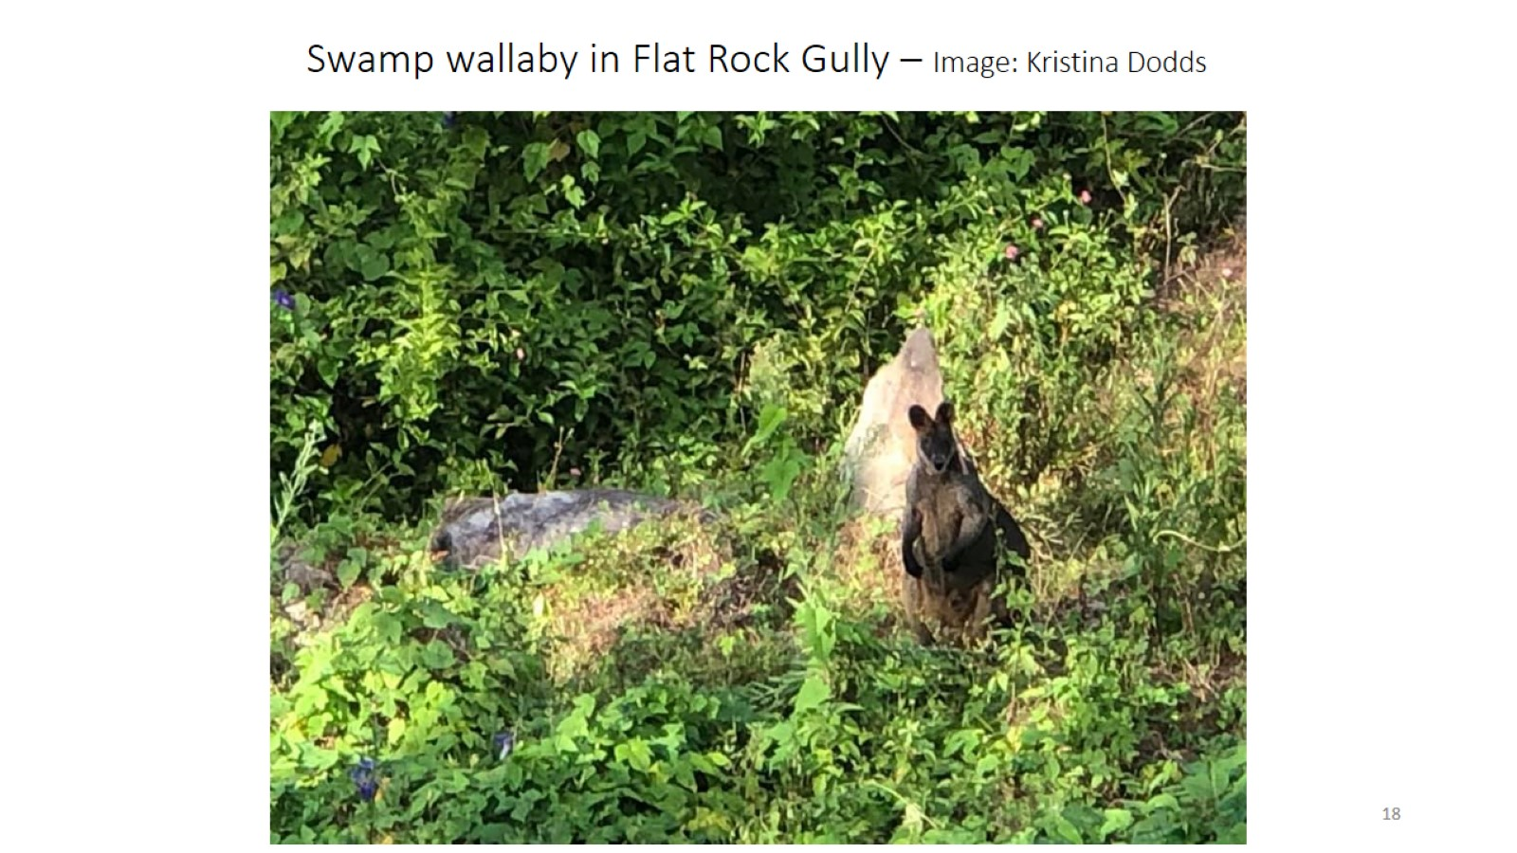
Swamp wallaby in Flat Rock Gully – Image: Kristina Dodds

Slide 19
Swamp Wallaby on Harbour Bridge – from article in Japanese media

Slide 20
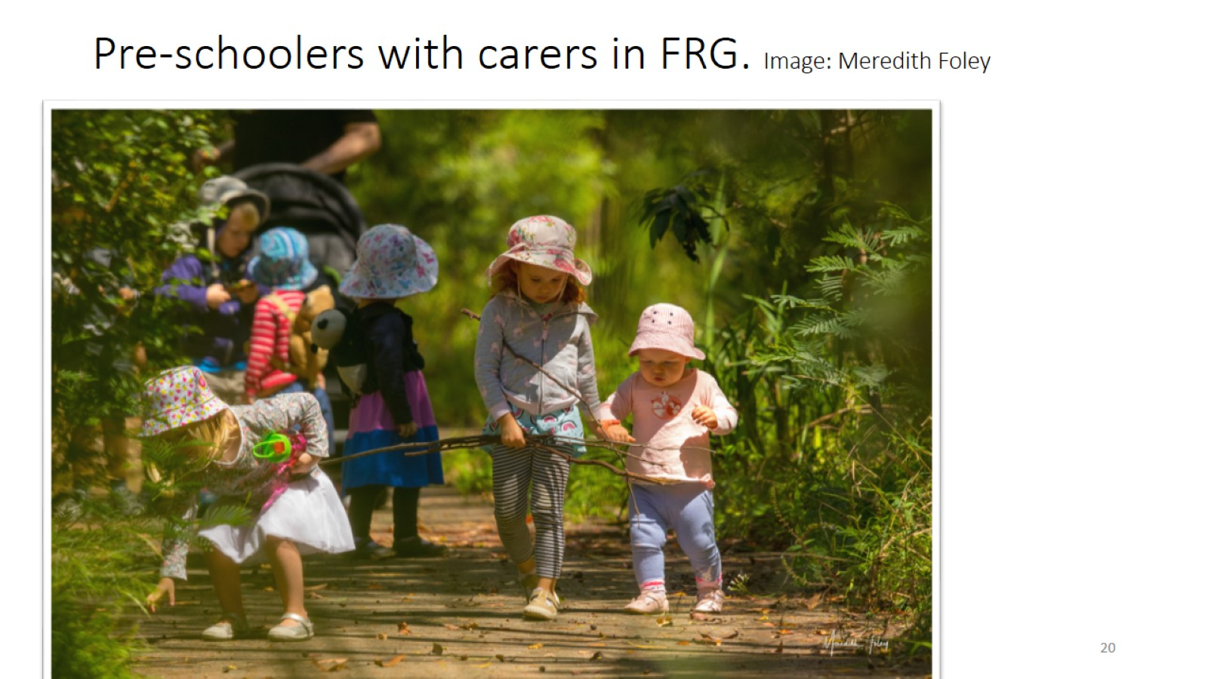
Pre-schoolers with carers in FRG. Image: Meredith Foley

Slide 21
Metro dive site, Marrickville

Slide 22
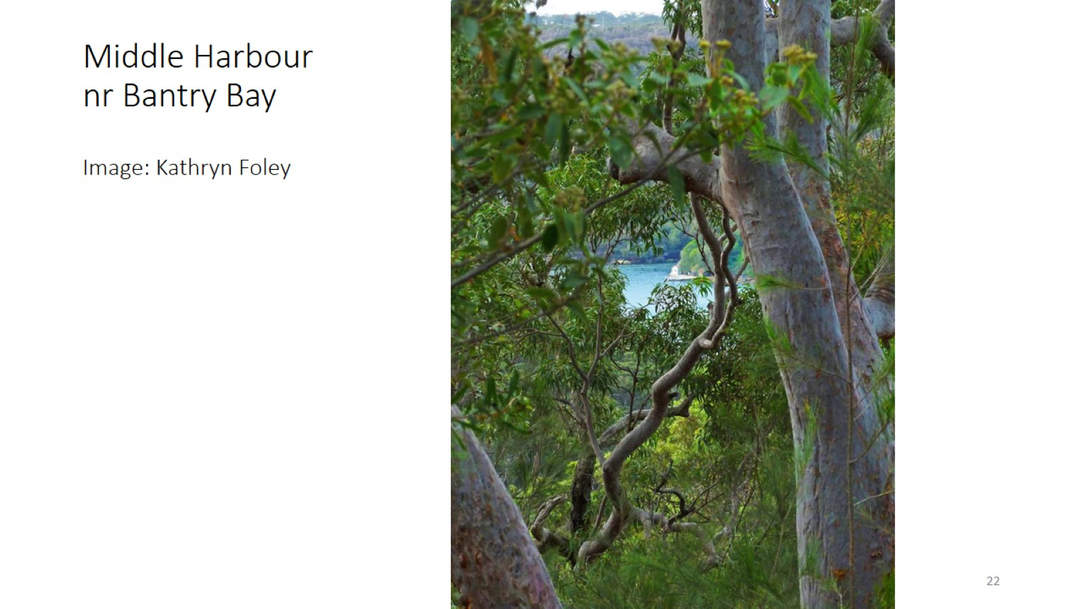
Middle Harbour nr Bantry Bay Image: Kathryn Foley

Slide 23
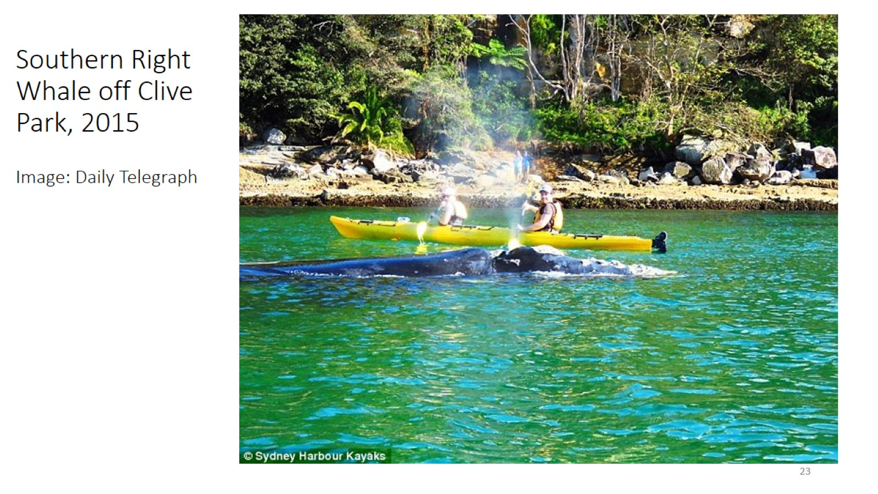
Southern Right Whale off Clive Park, 2015 Image: Daily Telegraph

Slide 24
Air ventilation stacks – the size of an 8 storey apartment

Slide 25
Chinese Trackless train recently launched

Slide 26
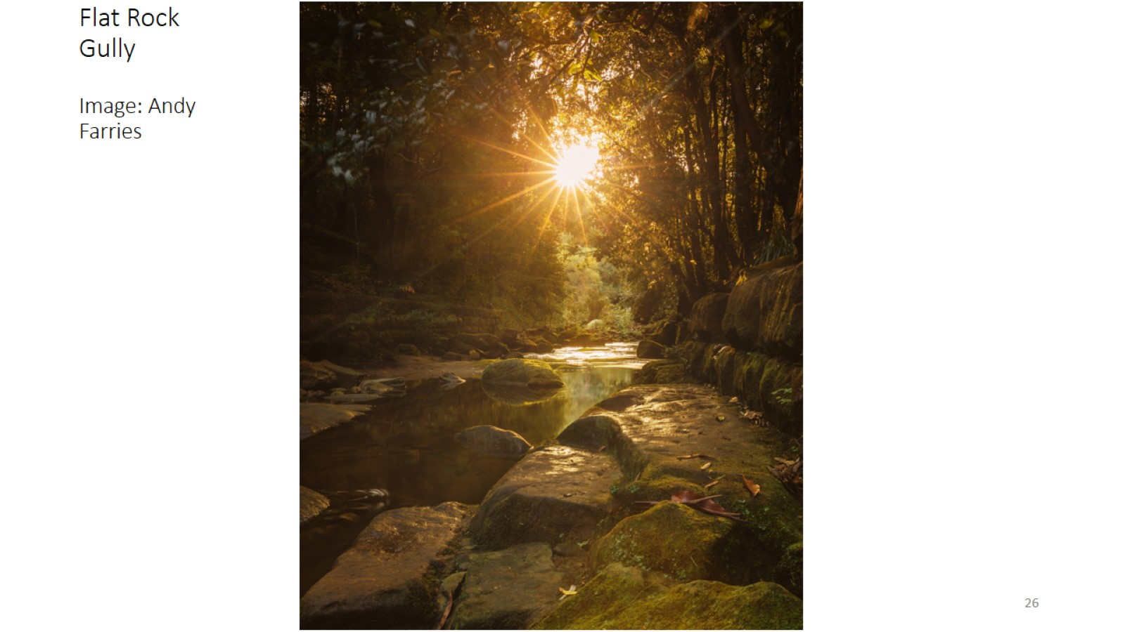
Flat Rock Gully Image: Andy Farries

